Slide 1
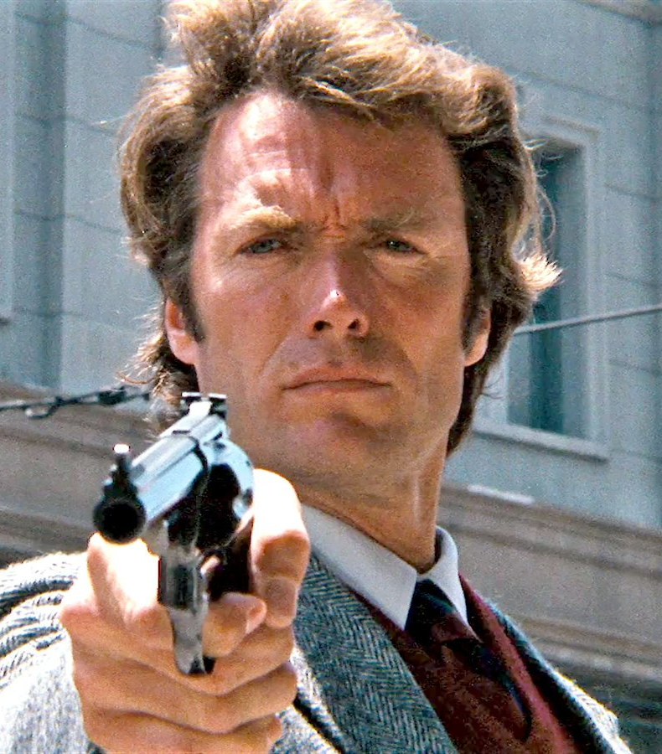
Go ahead, make my program
You’ve got to ask yourself one question: ‘Do I feel lucky?’ Well, do you, punk?
Prof. Darrell Long
CSE 13S

